Slide 1
3sided Pyramid @ PAPYRUS Run 5th-9th August Data from 8th August
Muskan Shinde

Slide 2
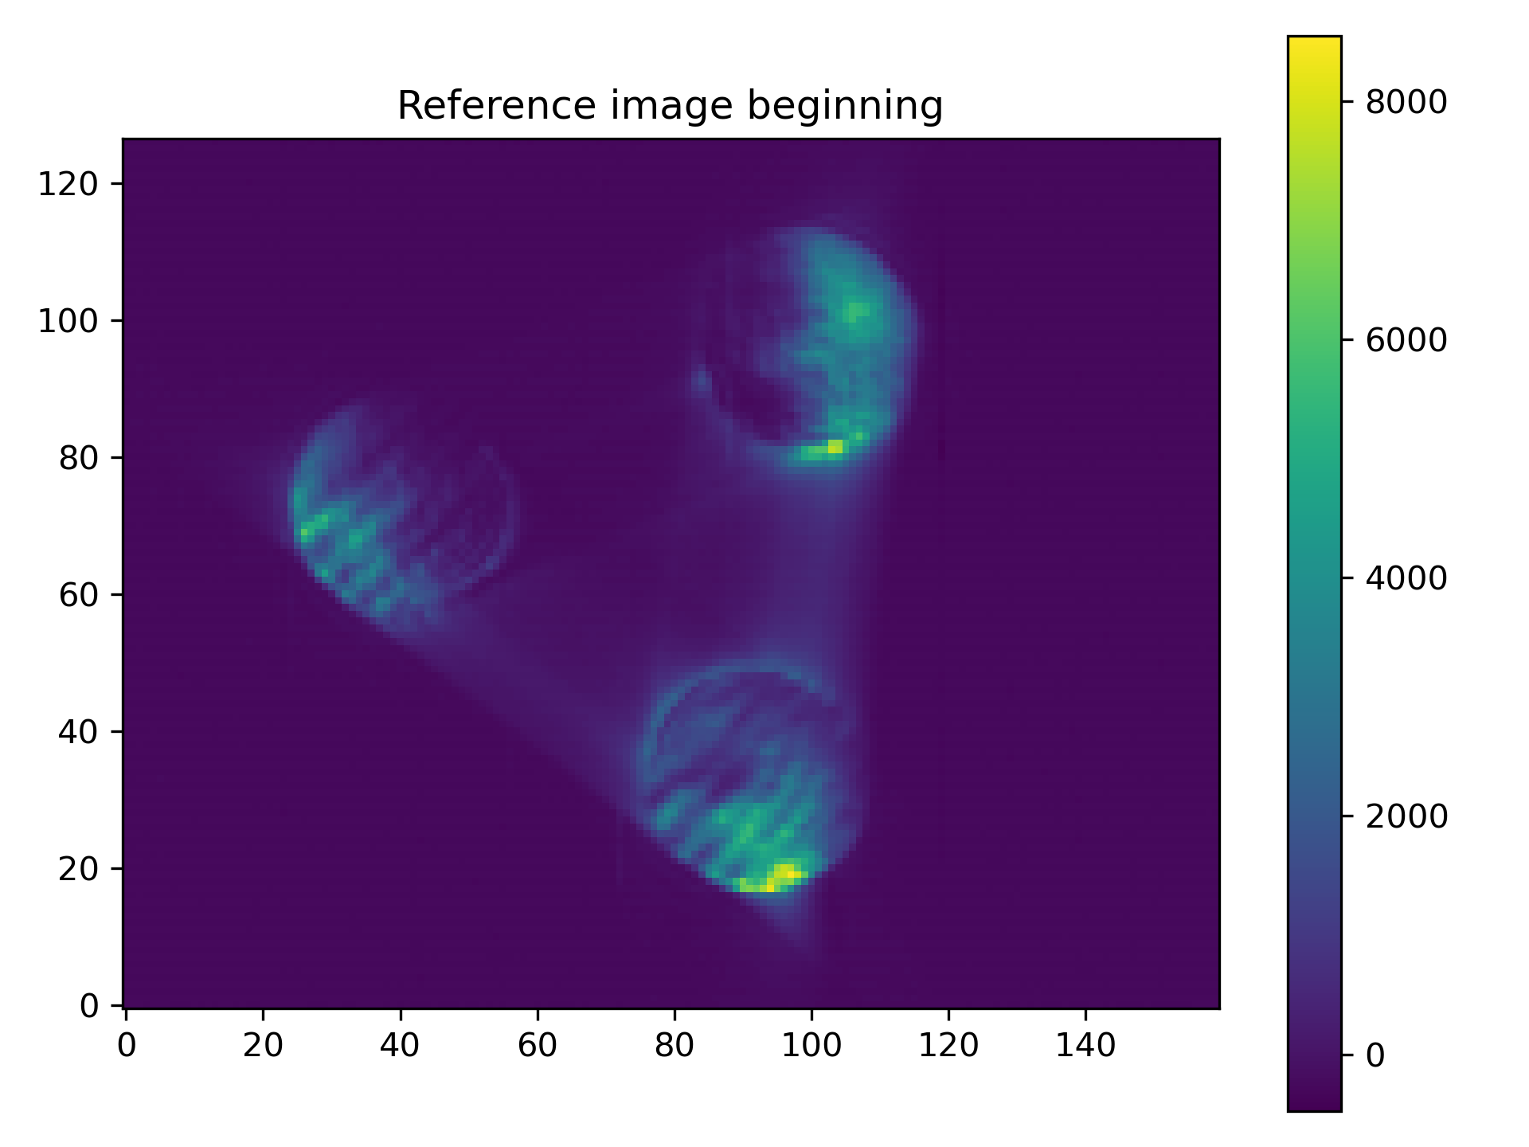
First image
after increasing the pupil sampling to 35 pixels

Slide 3
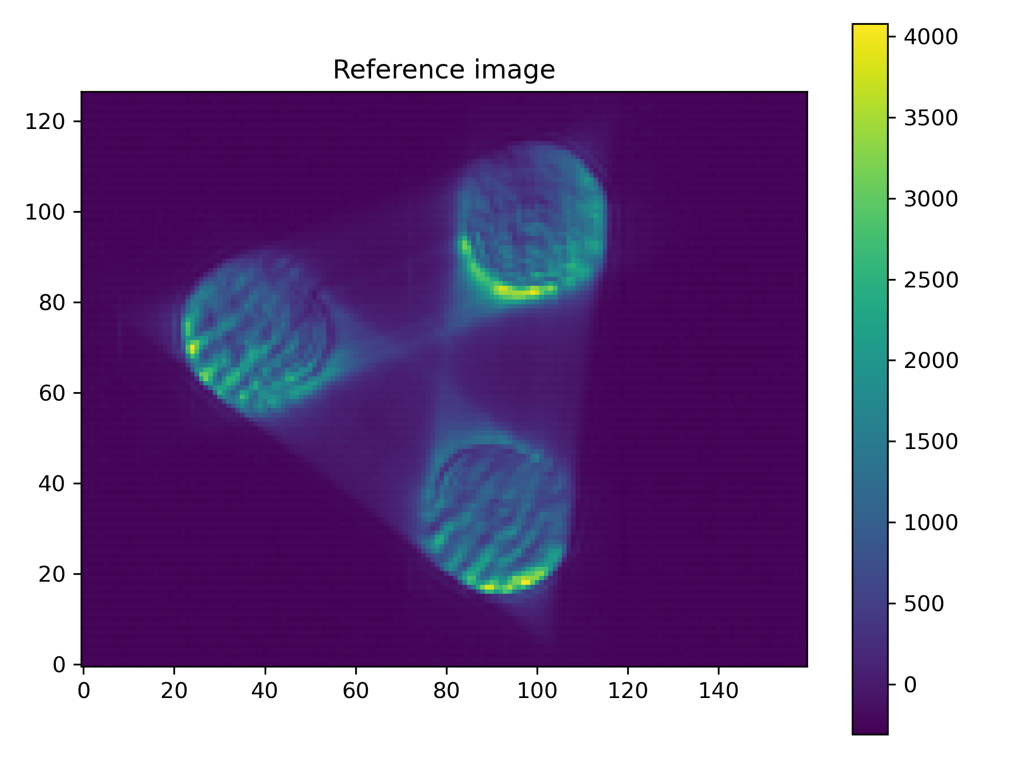
Finding a good flat
After repeated closing the loop on first 5-10 modes and calibrations

Slide 4
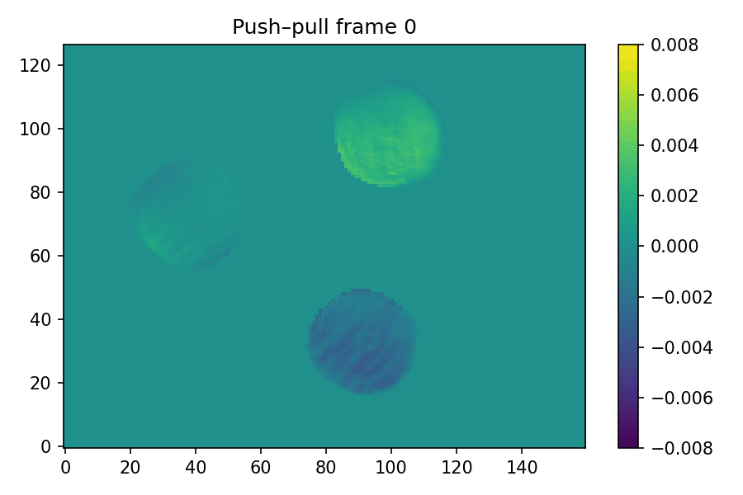
Push-Pull Calibrations
Calibration procedure:
Took 100 measurements of push and pull for each of the first 150 modes

Slide 5
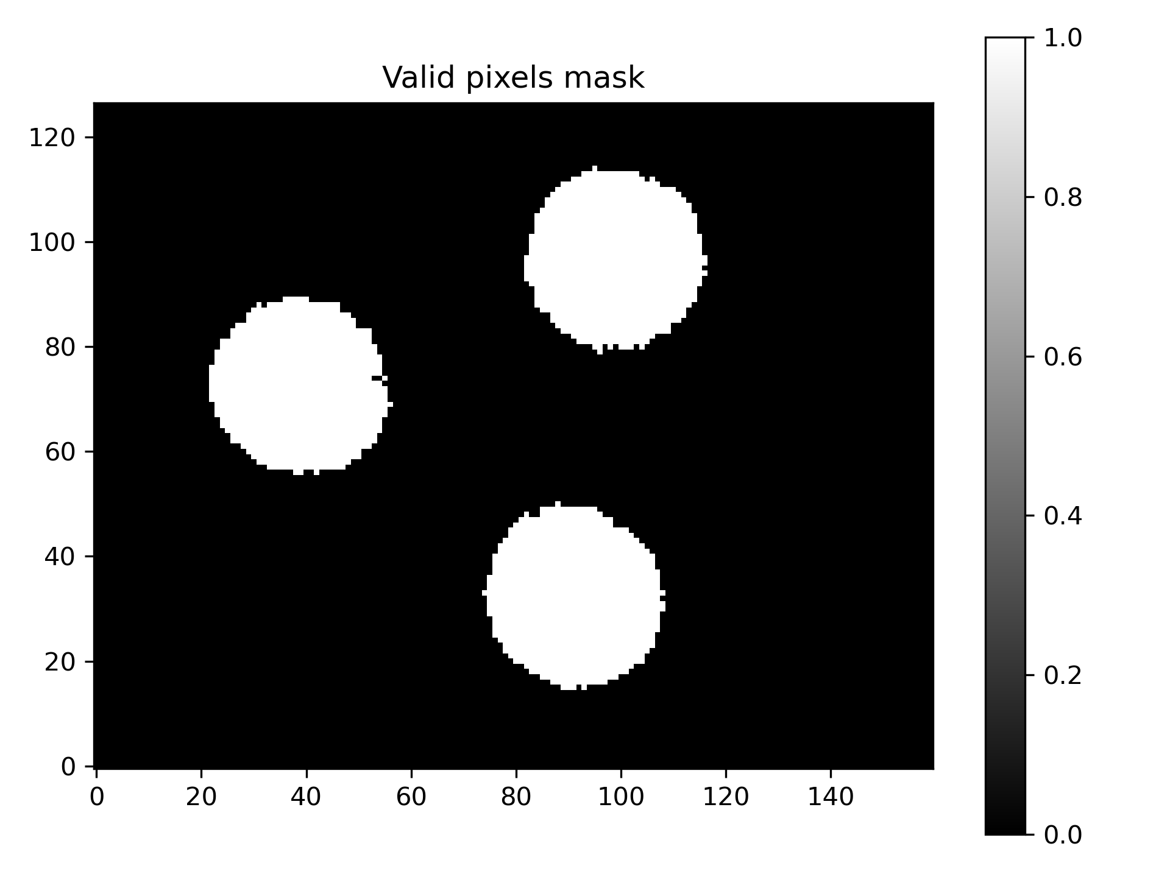
Valid Pixels Mask

Slide 6
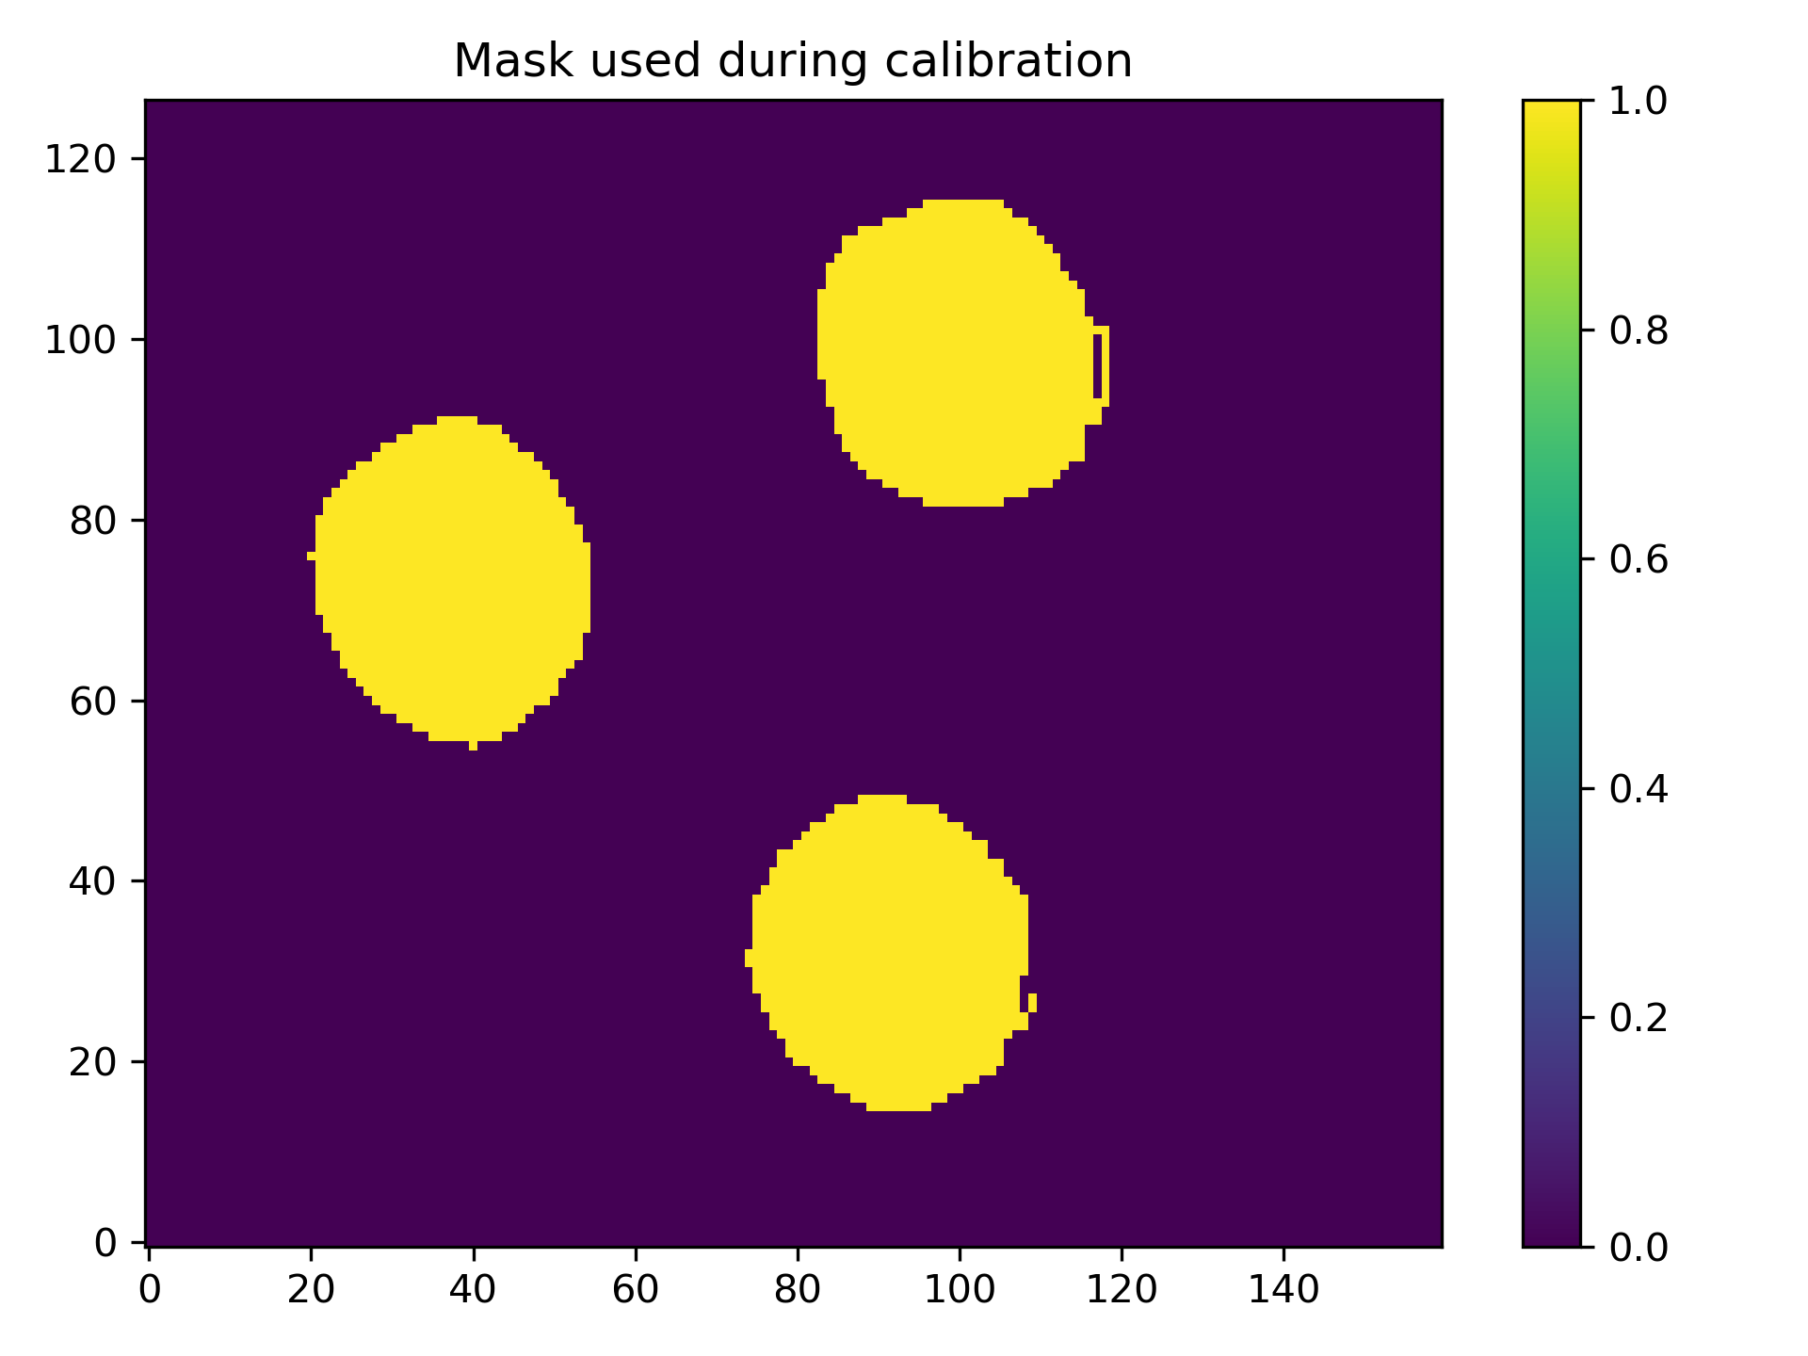
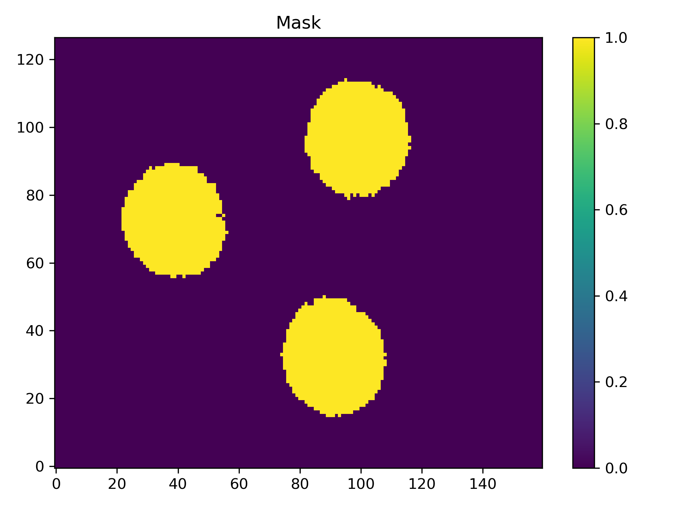

Problem in the calibration!
The full images during calibrations were NOT saved, only the masked images were saved.
And the mask was changed after.
Zeros added in the interaction matrix

Slide 7
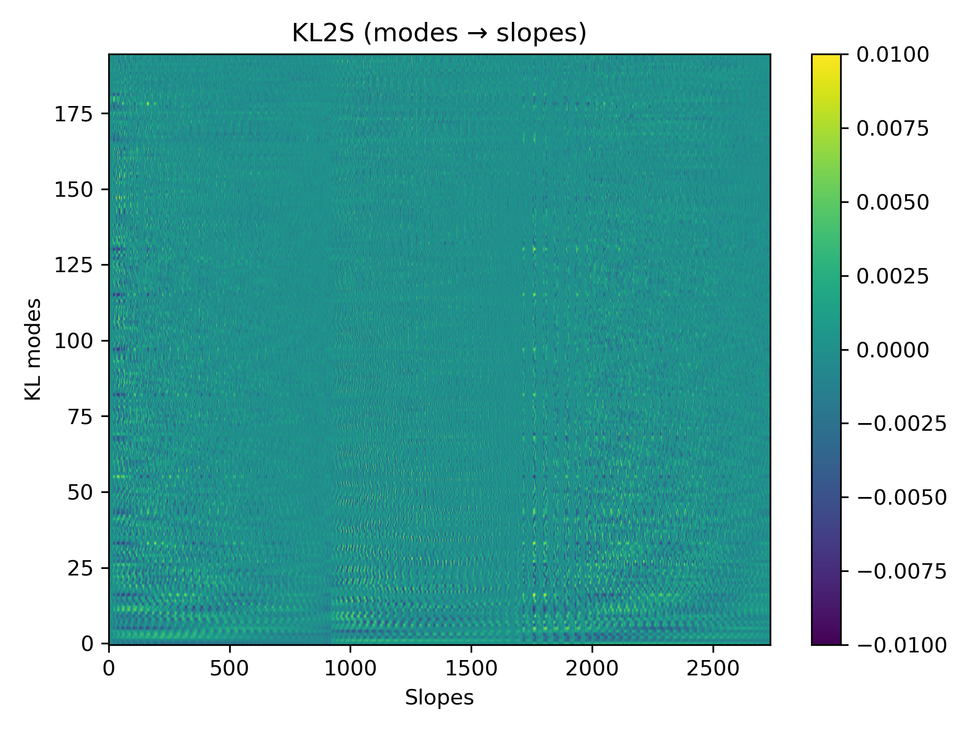
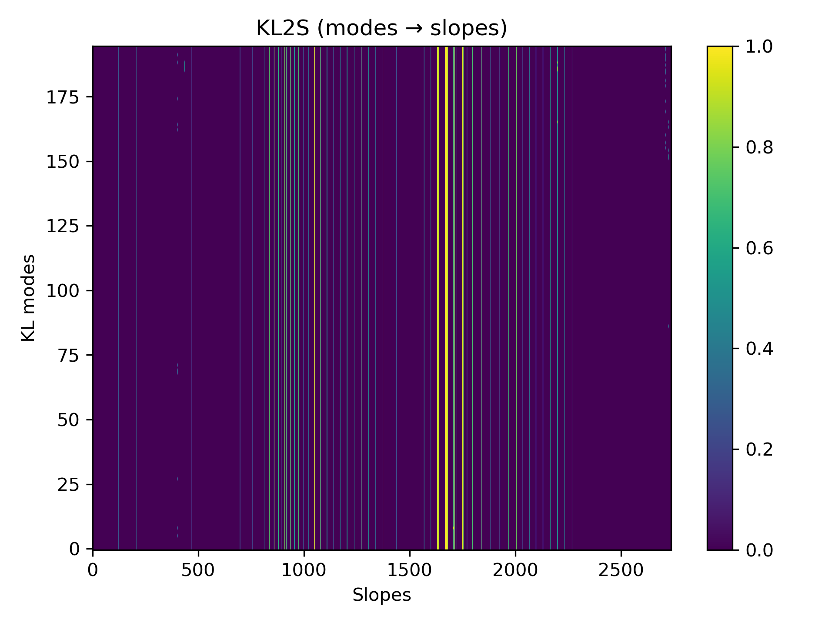
There are some zeros in the the interaction matrix

Slide 8
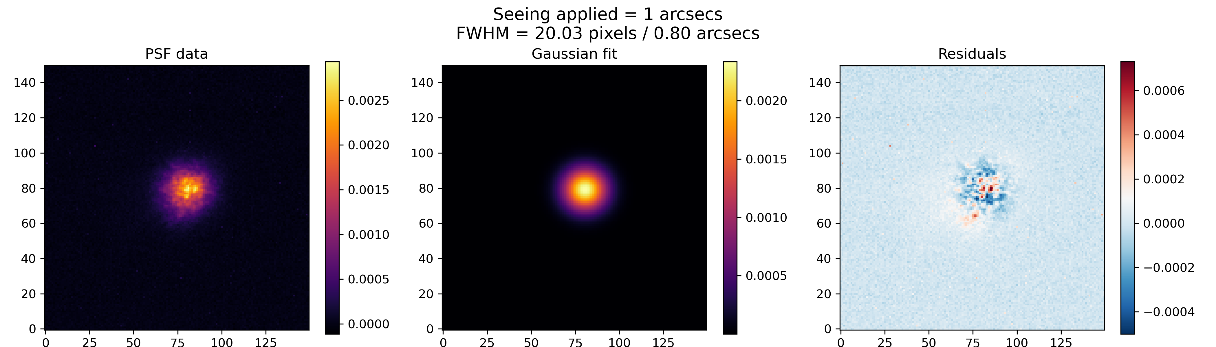
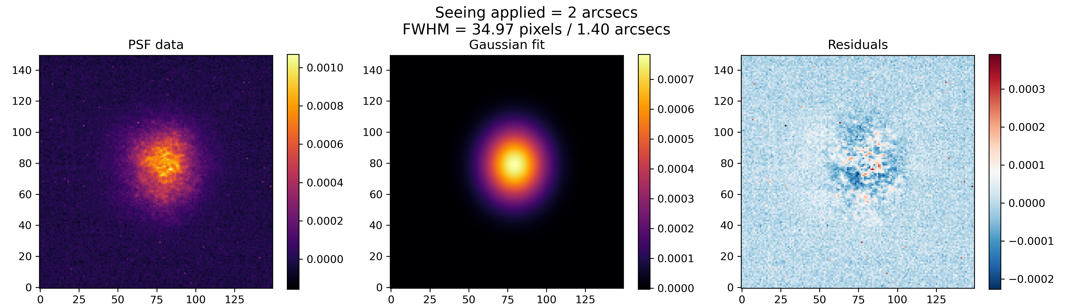
Applying Turbulence through DAO GUI
Applied seeing | Estimated seeing
4.0″ | 2.40″
3.0″ | 1.92″
2.0″ | 1.40″
1.0″ | 0.80″
Plate scale = 40 mas/pix

Slide 9
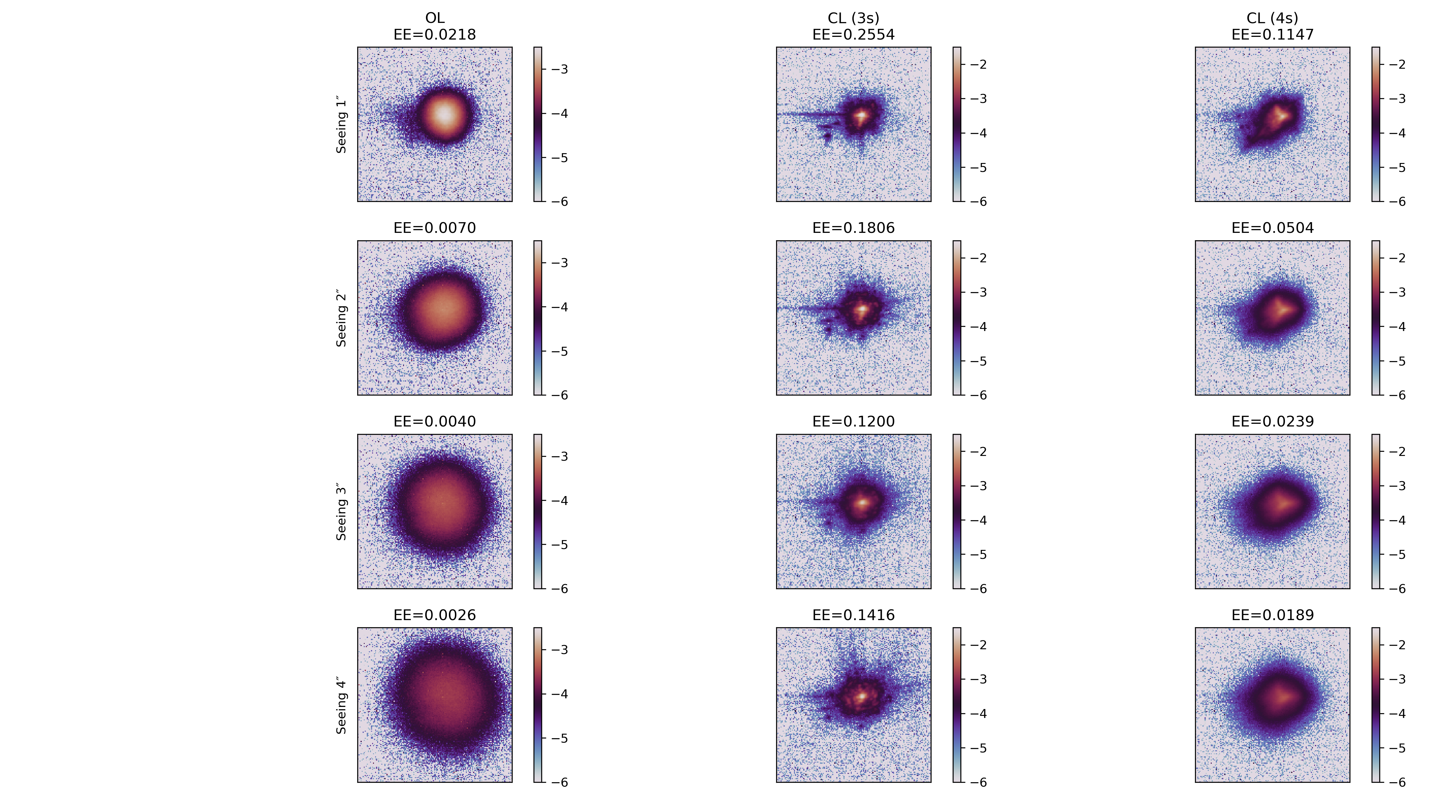
Closing loop
on injected turbulence
@ 500Hz
Turbulence speed: 500 Hz
3s pyramid speed: 500 Hz
4s pyramid speed: 500Hz

Slide 10
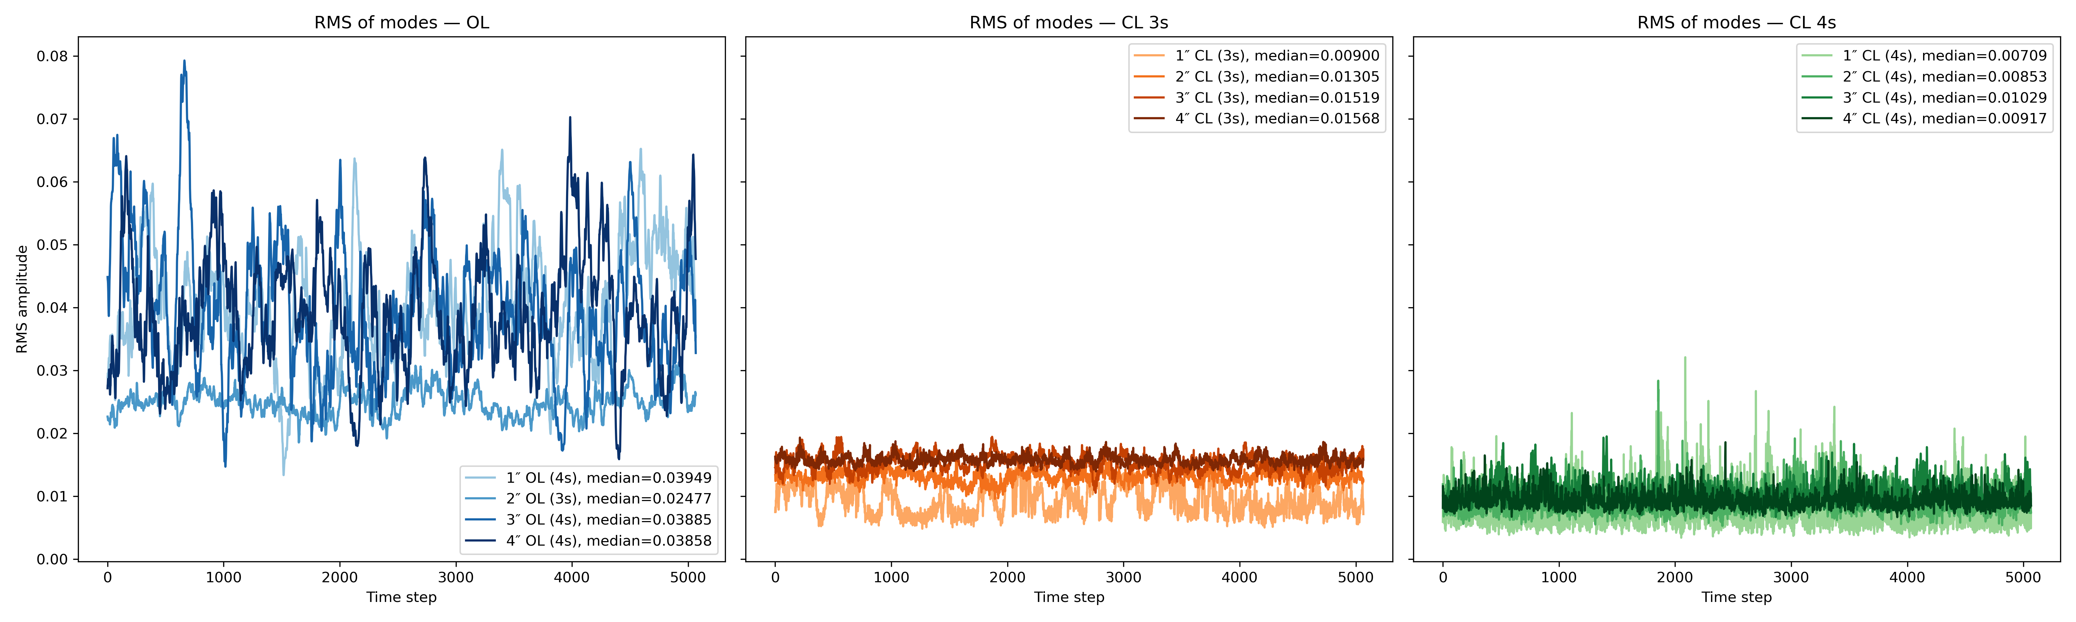
RMS residual modes measured by the pyramid
Why are the rms residual of the 3-sided pyramid higher than 4-sided pyramid?
4-sided pyramid is underperforming and what see are not true residuals
Calibration used was with modulation
Loop gain not set according to compensate optical gains

Slide 11
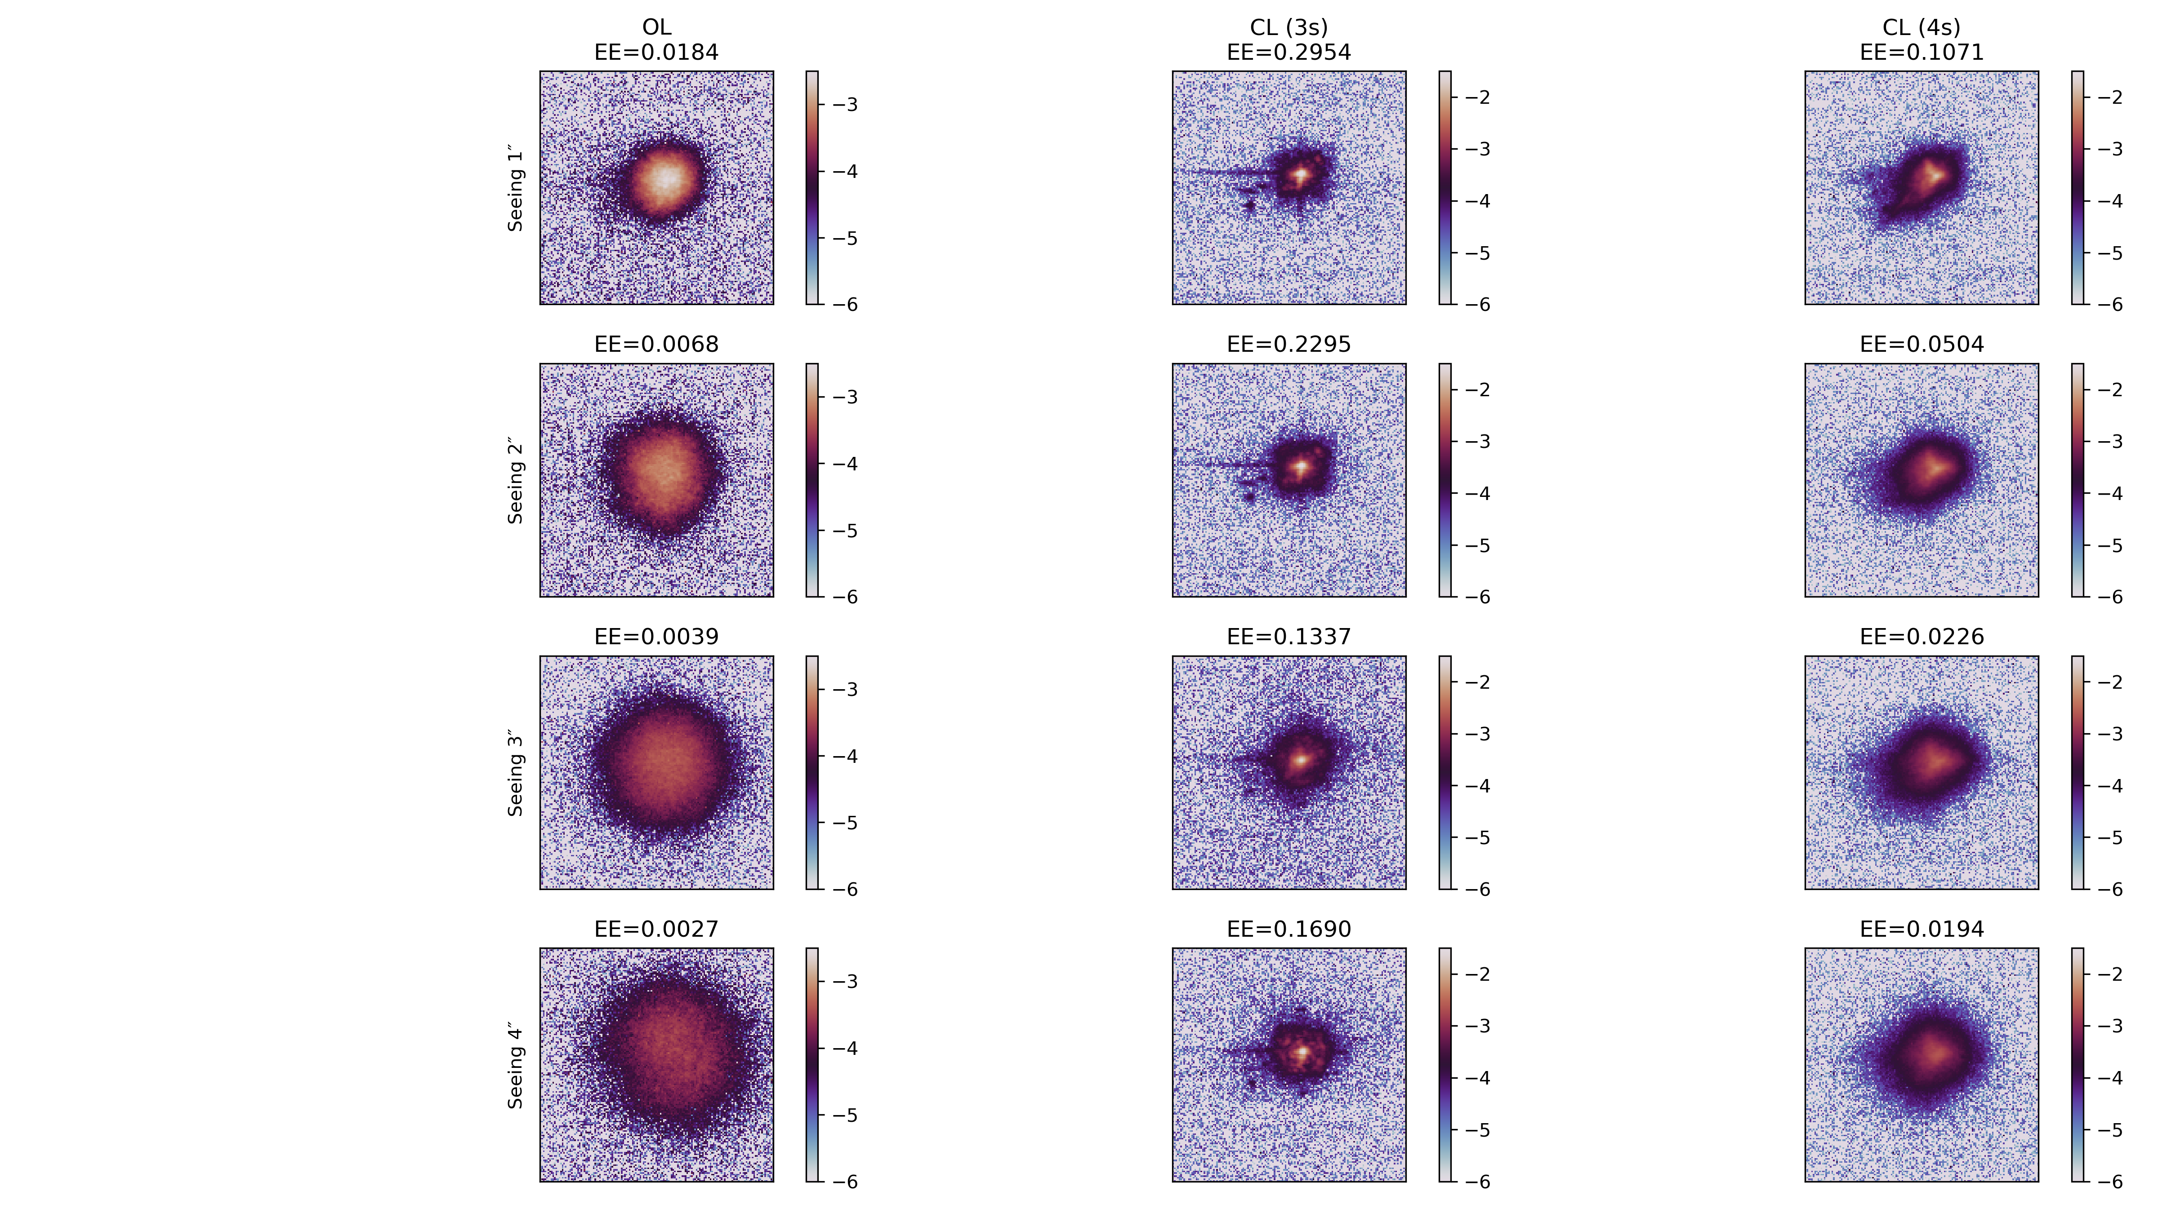
Closing loop
on injected turbulence
@ 1000Hz
Turbulence speed: 500 Hz
3s pyramid speed: 1000 Hz
4s pyramid speed: 500Hz
- What is 500 Hz turbulence?
- Is 3s Pyramid at 1000Hz observing the same frame twice?

Slide 12
Encircled Enery
is 3x3 pixels area around the center
Seeing | OL | CL (3s, 500 Hz) | CL (3s, 1000 Hz) | CL (4s, 500 Hz)
1″ | 0.0218 | 0.2554 | 0.2954 | 0.1147
2″ | 0.0070 | 0.1806 | 0.2295 | 0.0504
3″ | 0.0040 | 0.1200 | 0.1337 | 0.0239
4″ | 0.0026 | 0.1416 | 0.1690 | 0.0189

Slide 13
Missed frames
missed frames & duplicate frame during the day
Seeing | CL (3s, 1000 Hz)/CRED3 |  | CL (3s, 500 Hz)/CRED3 |  | CL (4s, 500 Hz)/OCAM
 | Missed frames | Duplicate frames | Missed frames | Duplicate frames | Missed frames | Duplicate frames
1″ | 1339.2 | 71 | 22 | 11 | 187.5 | 32
2″ | 191.3 | 158 | 59.5 | 56 | 193 | 18
3″ | 72.9 | 13 | 38.5 | 34 | 8 | 3
4″ | 320.2 | 287 | 106.5 | 98 | 49.5 | 17
avg | 480.9 | 132.3 | 56.6 | 49.8 | 109.5 | 17.5
~ 610 out 5000 frames
~ 12.2%
~106 out 5000 frames
~ 2.1%
~127 out 5000 frames
~ 2.5%

Slide 14
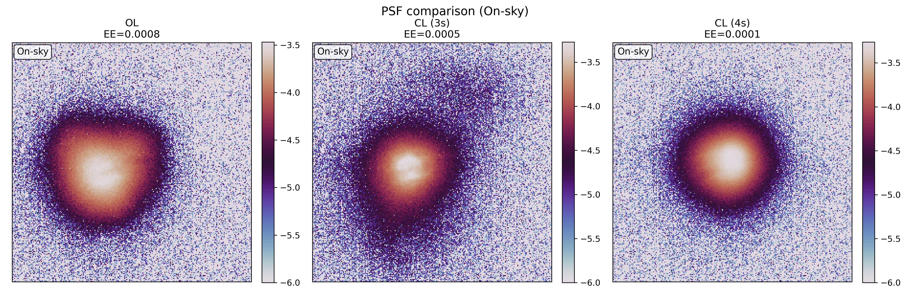
On Sky tests
3s pyramid speed: 1000 Hz
4s pyramid speed: 500Hz
Why the 3s pyramid could not work on sky?
NIR pupil conjugation issue?
NIR pupil vignetting?
Too many missed frames?

Slide 15
Missed frames
missed frames & duplicate frame during the night
CL (3s, 1000 Hz)/CRED3 |  | CL (4s, 500 Hz)/OCAM
Missed frames | Duplicate frames | Missed frames | Duplicate frames
438.8 | 314 | 150 | 13
~ 753 out 5000 frames
~ 15%
~ 163 out 5000 frames
~ 3.3%
Most of the times there was a missed frame after a duplicate frame

Slide 16
To Do for next time:
Fix the saving of full calibration with all the frames
Complete telemetry with slopes and frame counter
Record data while closing the loop
Reduce the missed frames & jitter - put code in DAO
Synchronize taking data from 3s and 4s pyramid
Synchronize with turbulence
PSF centering algorithm
Make a workbook to take the data
Optical gains for 4s pyramid
Analysing the data from 7th August
Internal turbulence injection studying

